Slide 1

POLLUCHECK

Slide 2
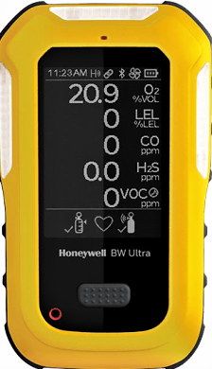
PROCESS
Collects the pollution data using the detectors.
The data will be sent to the cloud in real time.
The data will be stored and analyzed in the cloud.
Open access of analyzed data to the users.

Slide 3
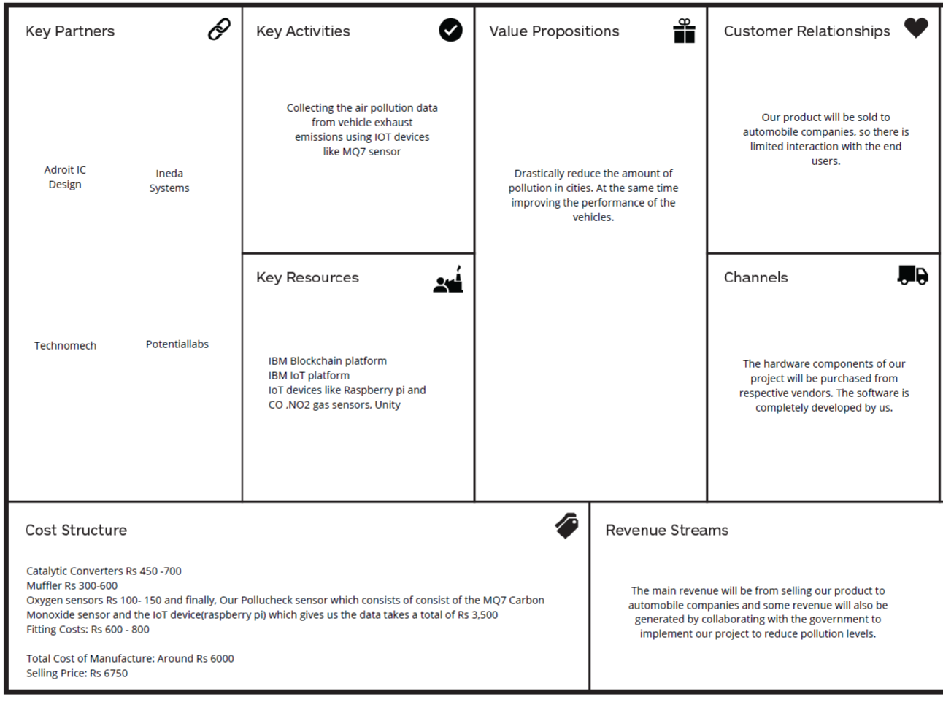
BUSINESS MODEL

Slide 4
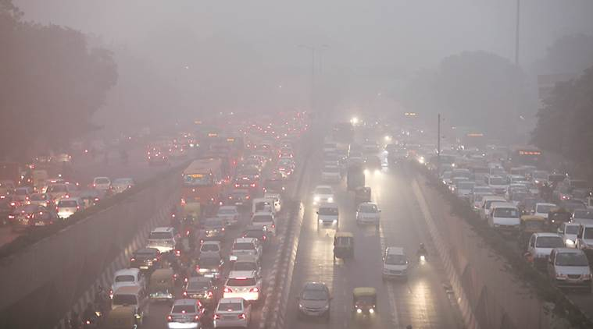
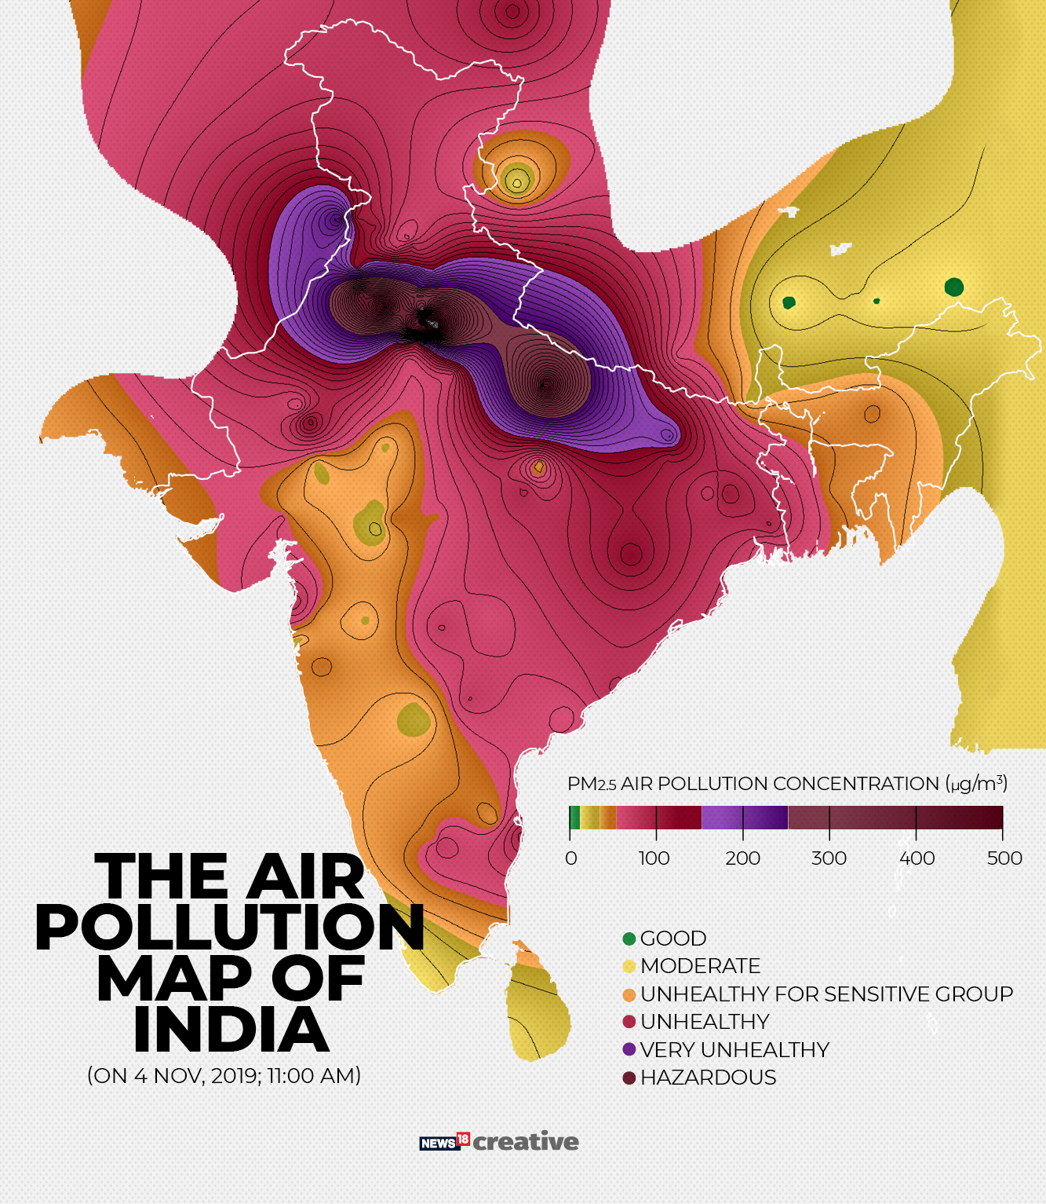
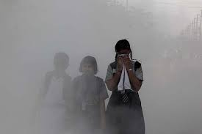
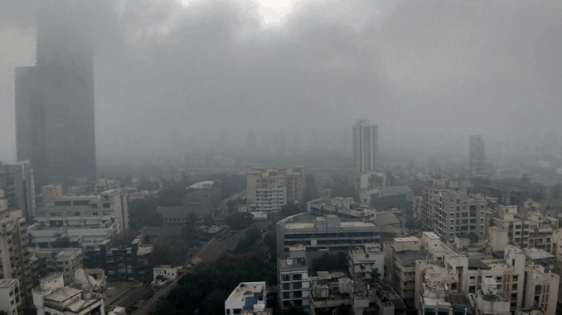
Motive Behind:

Slide 5
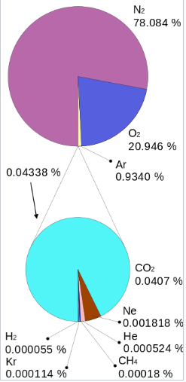
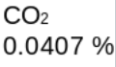
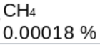
Air composition
Quantitative view on air pollution
[1]
[1] Global Greenhouse Gas Reference Network, NOAA, 2019, retrieved 2019-05-31

Slide 6
Contributors of pollution
61.4%
CO
34%
Reacts with other pollutants in the air to form potentially harmful ground level ozone.
HC
Incomplete combustion resulting in high hydrocarbons
3.8%
NOx
Readily reacts with common organic chemicals and even ozone, to form a wide variety of toxic products and lead to acid rain.
SO2
0.5%
Irritation to the skin and membranes of the eyes, nose, throat, and lungs.
0.3%
SPM+Pb
Suspended particulate matter causes severe pollution to the surroundings.

Slide 7
PROCESS FLOW OF THE PROJECT
Engine exhaust data is collected.
Collected data is stored in cloud database.
The data is processed in the IBM cloud IoT platform.
The data is accessed by dedicated mobile app and webpage created for this project.
5. The app and webpage display data like carbon credits earned by the user, engine report of the vehicle, the device health and payment details of any challans.

Slide 8
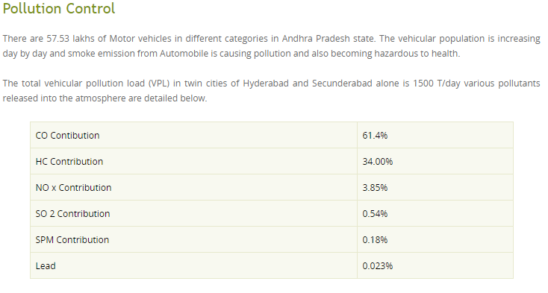
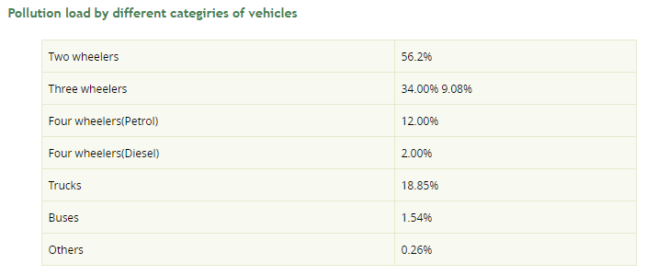
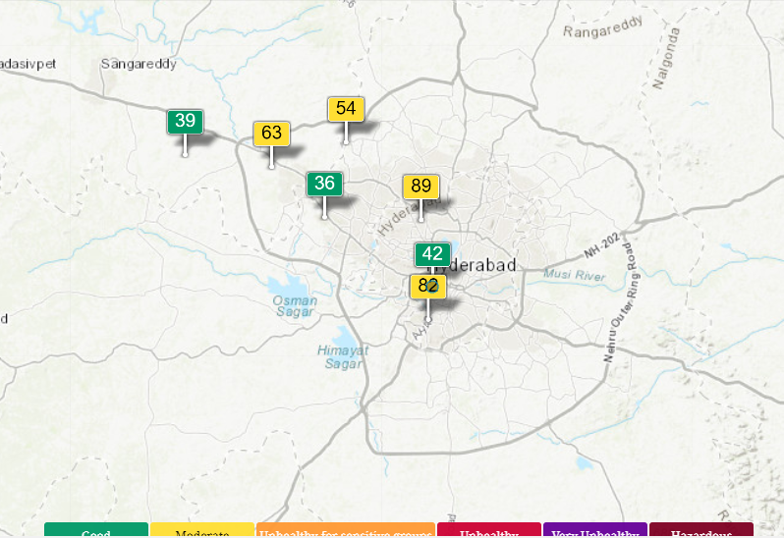
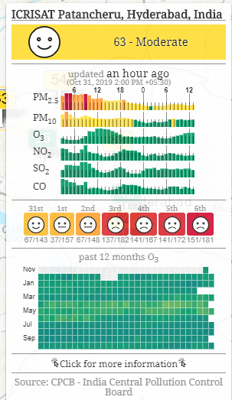
https://aqicn.org/map/hyderabad/

Slide 9
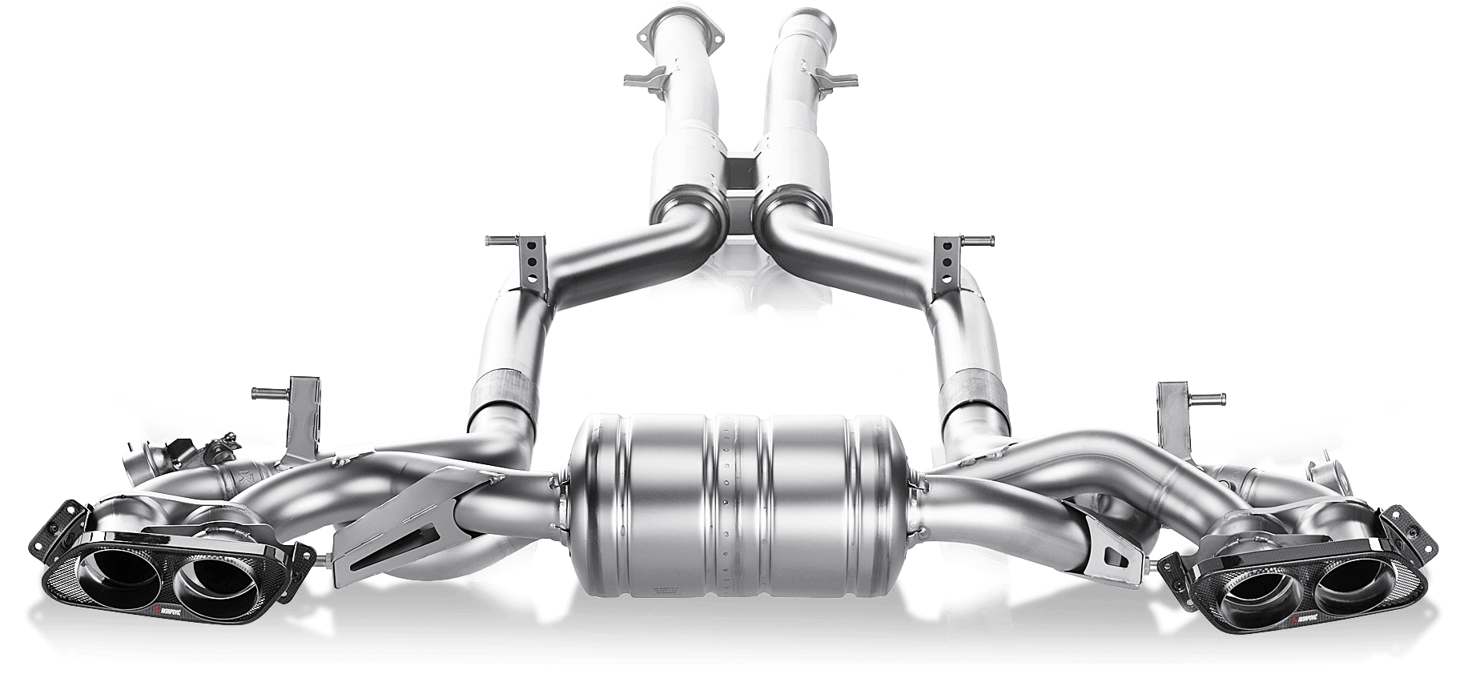
Exhaust system
An exhaust system is usually piping used to guide reaction exhaust gases away from a controlled combustion inside an engine or stove. The entire system conveys burnt gases from the engine and includes one or more exhaust pipes.

Slide 10
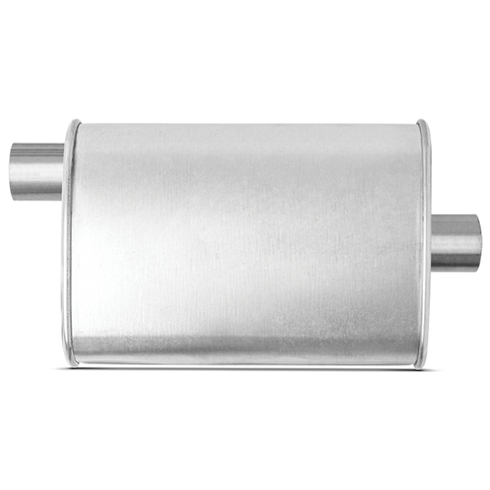
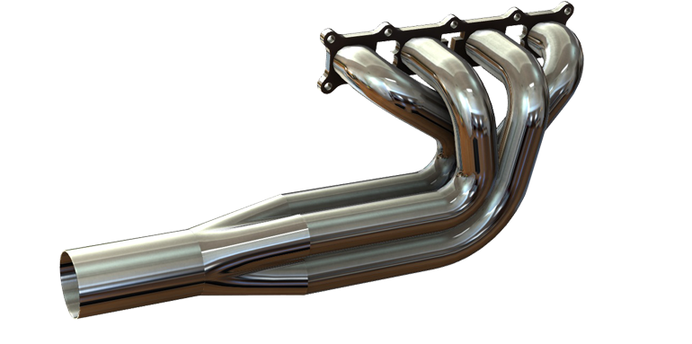
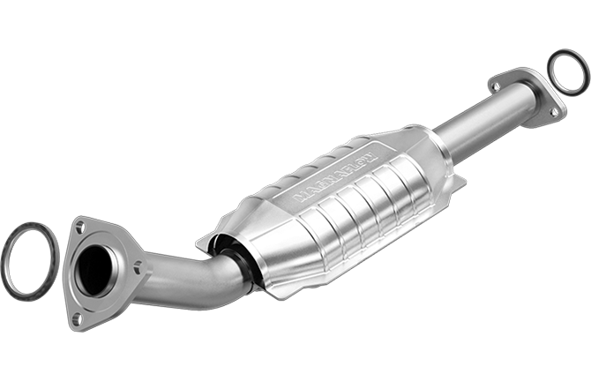
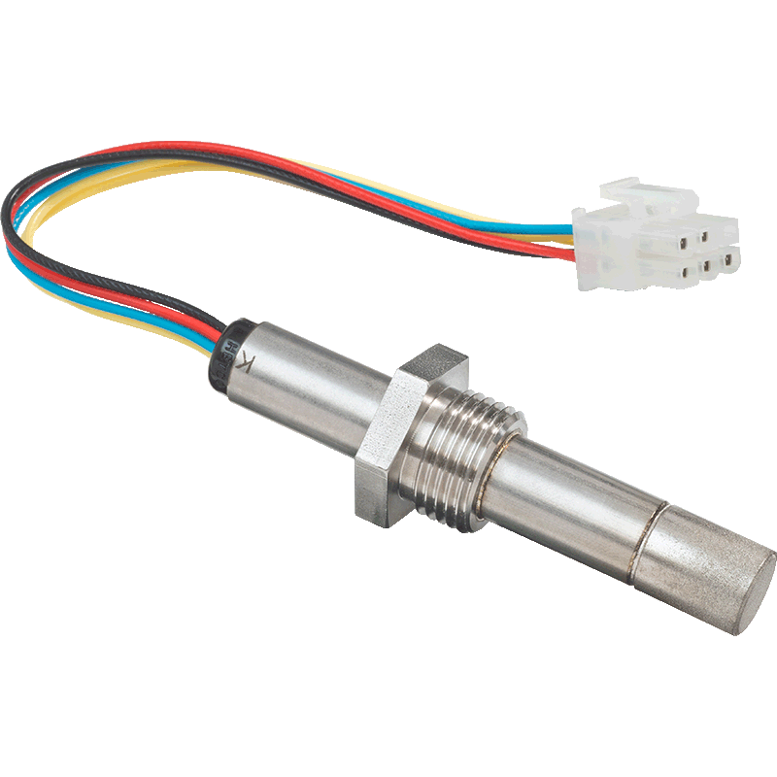
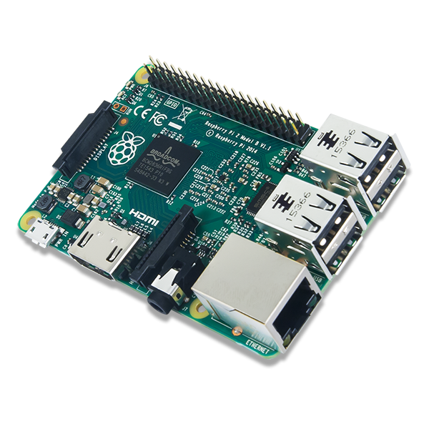
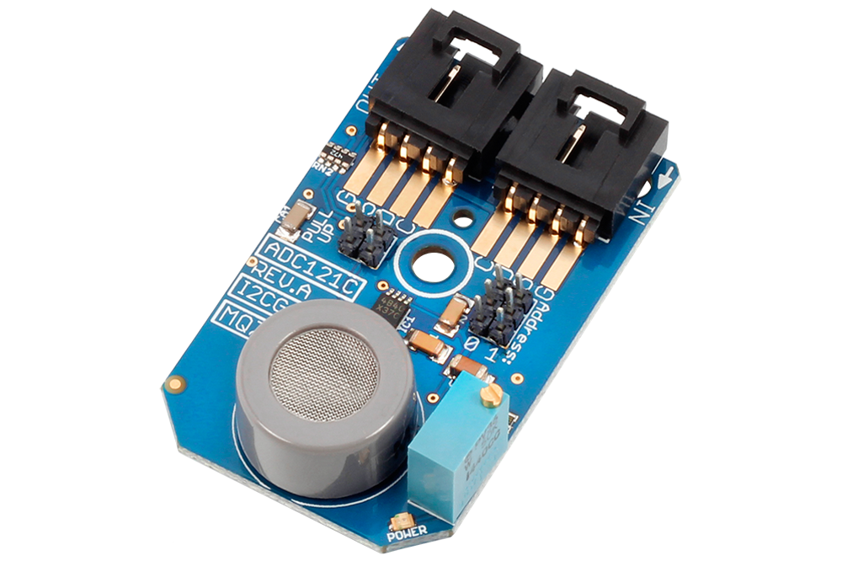
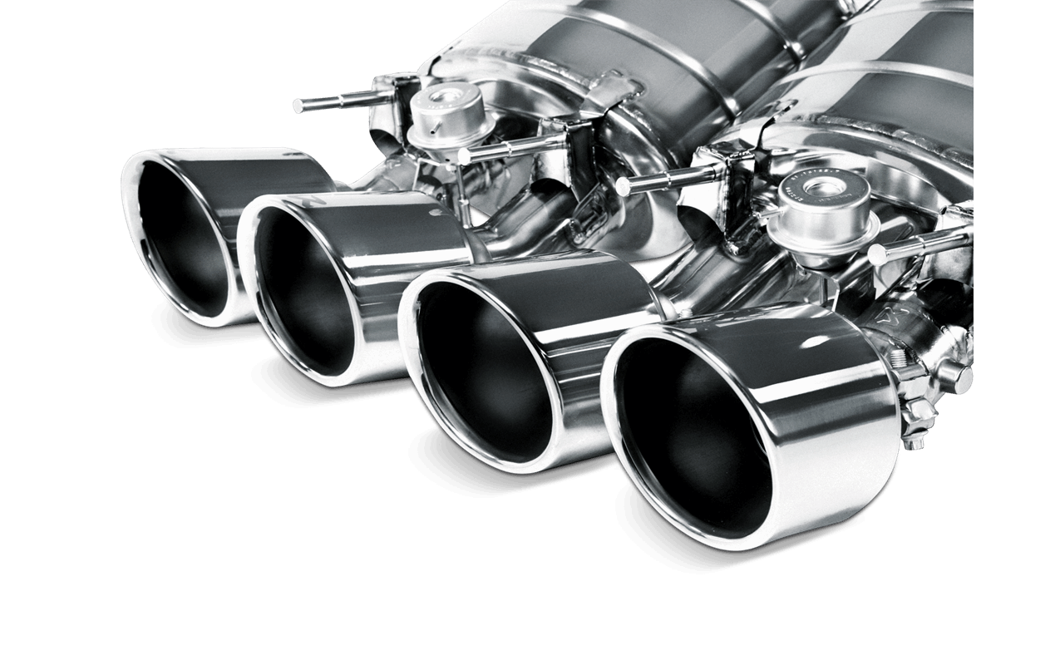
Components
1. Exhaust Manifold 2.Catalytic Converters 3. Muffler 4. Oxygen sensors
5. Exhaust Pipe 6.MQ7 CO Sensor 7.Raspberry Pi 3

Slide 11
POTENTIALLY ATTRACTABLE COMPANIES
HYUNDAI :
Settlement with the U.S. Environmental Protection Agency (EPA) and U.S. Department of Justice.
Agreed to pay a $47 million civil penalty for violating Title II of the Clean Air Act
Sold heavy construction vehicles with diesel engines that were not certified to applicable emission standards.
HONDA :
The latest short film in the company's Environmental Short Film series--this one titled "Never Ending Race"--depicts Honda's efforts to respond to the far stricter Federal and state environmental legislation in the 1970s that resulted from efforts to improve the heavy air pollution in around the world.
TATA :
Tata which always has worked hard to get out in front of its critics, at least on air pollution.
.

Slide 12
CAC
Customer acquisition costs (CAC)
Events | Approximate Costs
Campaigning & Advertisements | Rs 4,00,000
Targeted Customers in 1 Year | Rs 10000
CAC = Sales and Marketing expenses/ Number of new customers
Approximate Value of CAC = Rs 40

Slide 13

THANKYOU
Pace Setters

